Slide 1
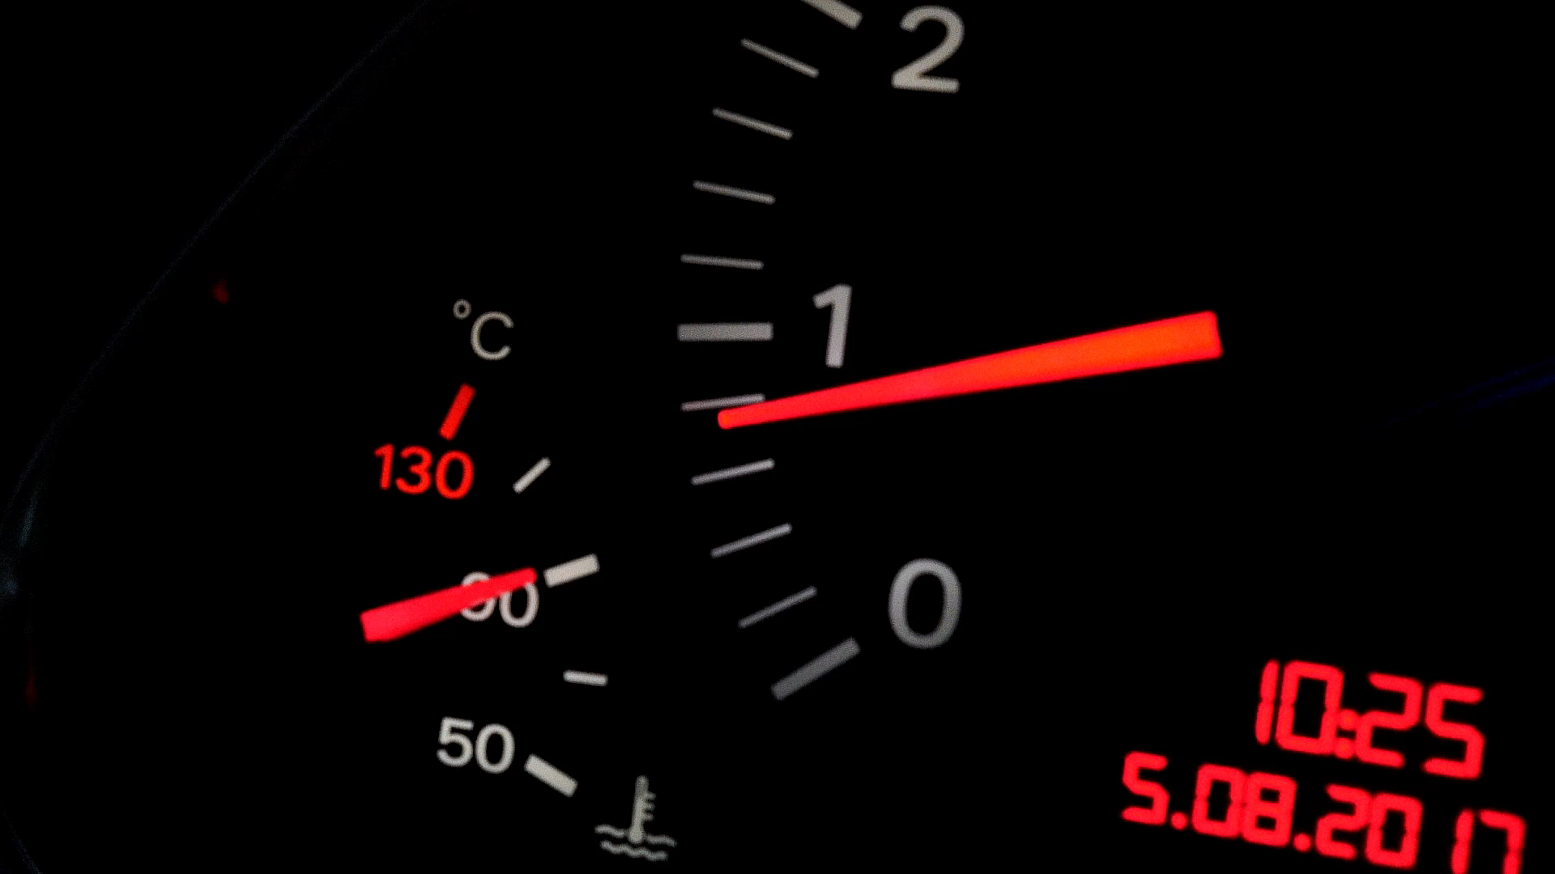
Comprehensive Admin Dashboard for E-Commerce
Sandeep Subbiah Selvakumar
11/03/2023
Sand Companies Limited

Slide 2
Introduction
The purpose of an admin dashboard is to serve as a user interface for administrators to interact with the back-end of a website, application, or system. It provides a visual overview of key performance indicators (KPIs), metrics, and other important data in one central place. Through the dashboard, administrators can manage the system, configure settings, control user access, monitor system health and performance, and make decisions based on the aggregated information. It's a crucial tool for efficient management and timely decision-making in a wide range of applications from web services to enterprise software systems.

Slide 3

Objective
Streamlining Operations: The dashboard is designed to simplify and optimize the various processes within an organization. By providing a clear and concise view of all operational metrics and data points, it helps administrators identify bottlenecks, track progress, and implement improvements more effectively, thereby increasing efficiency and productivity.
Centralized Management: Centralization is about having a single point from which to manage multiple functions and systems. An admin dashboard brings together controls and information from disparate sources, allowing administrators to manage the system from one location. This central view can significantly reduce the complexity of managing large systems and make it easier to perform administrative tasks.
User Role Management: This objective pertains to the ability to define, assign, and manage the access and privileges of different users within the system. The dashboard should provide tools to create roles, set permissions, and oversee user activity. Effective user role management ensures that individuals have the appropriate level of access to perform their jobs, enhancing security and operational integrity.
Inventory Control: For systems that involve inventory management, the dashboard is tasked with providing a real-time view of inventory levels, tracking stock movements, and predicting inventory needs. It should facilitate order management, stock replenishment, and the identification of trends or issues related to inventory, such as overstock or understock situations.
Each of these objectives contributes to the overall goal of the admin dashboard: to empower administrators with the ability to efficiently oversee and manage the system, ensuring that it runs smoothly, securely, and in line with organizational goals.

Slide 4
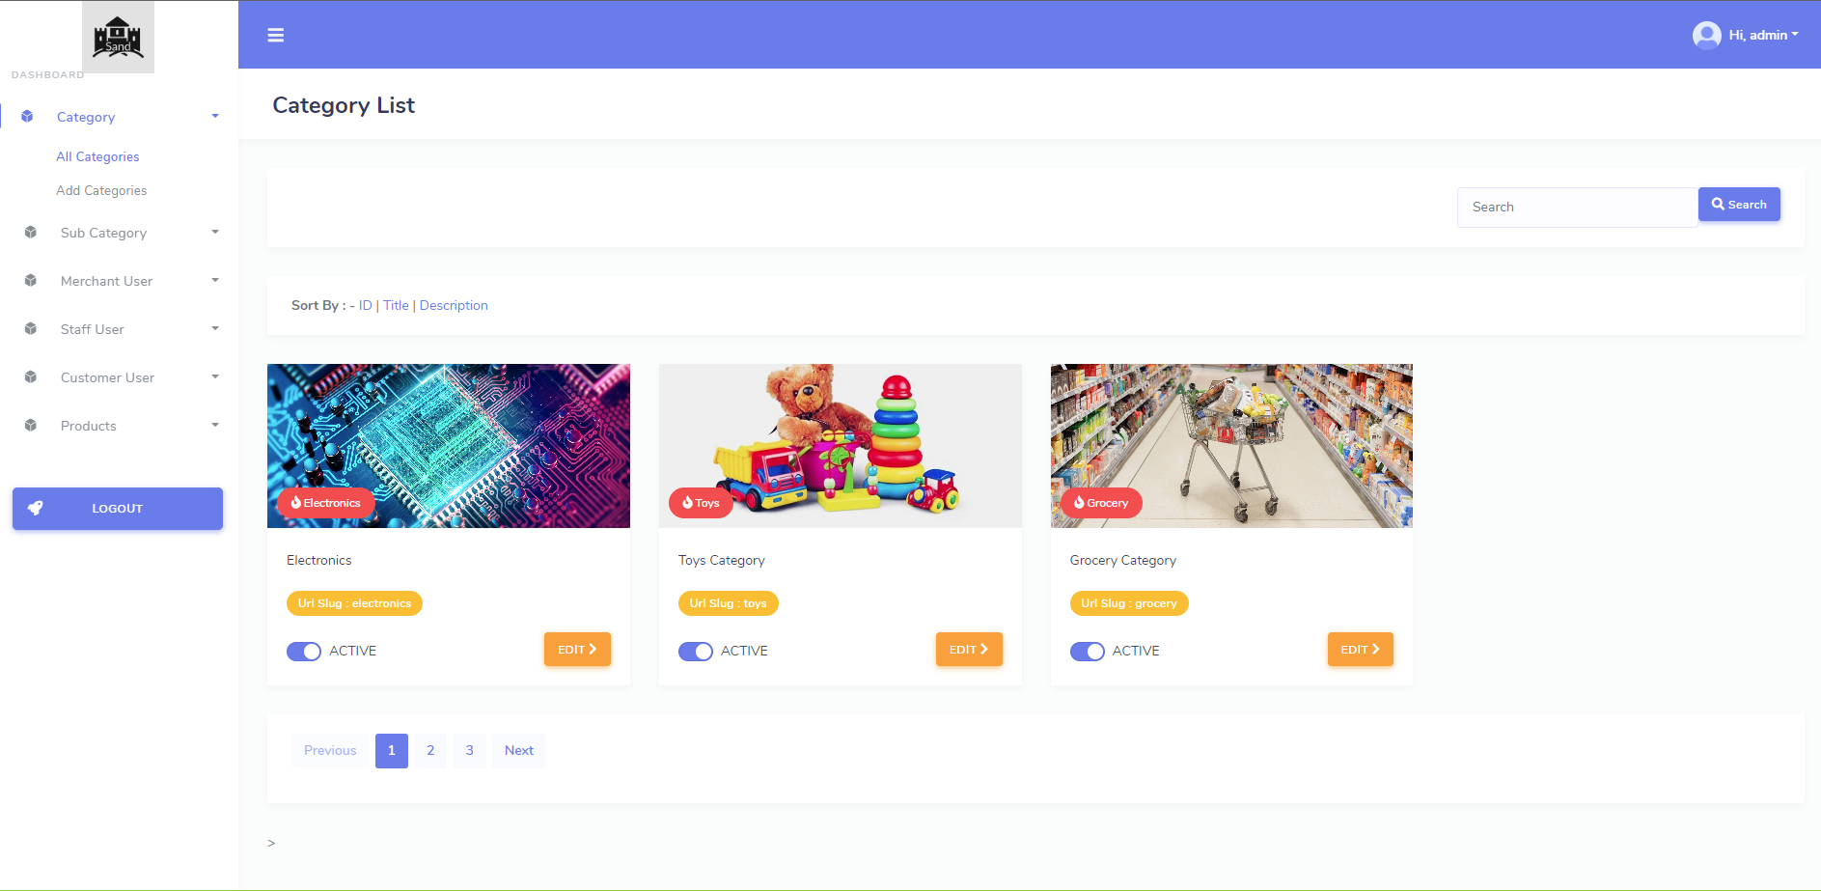
Dashboard Overview

Slide 5
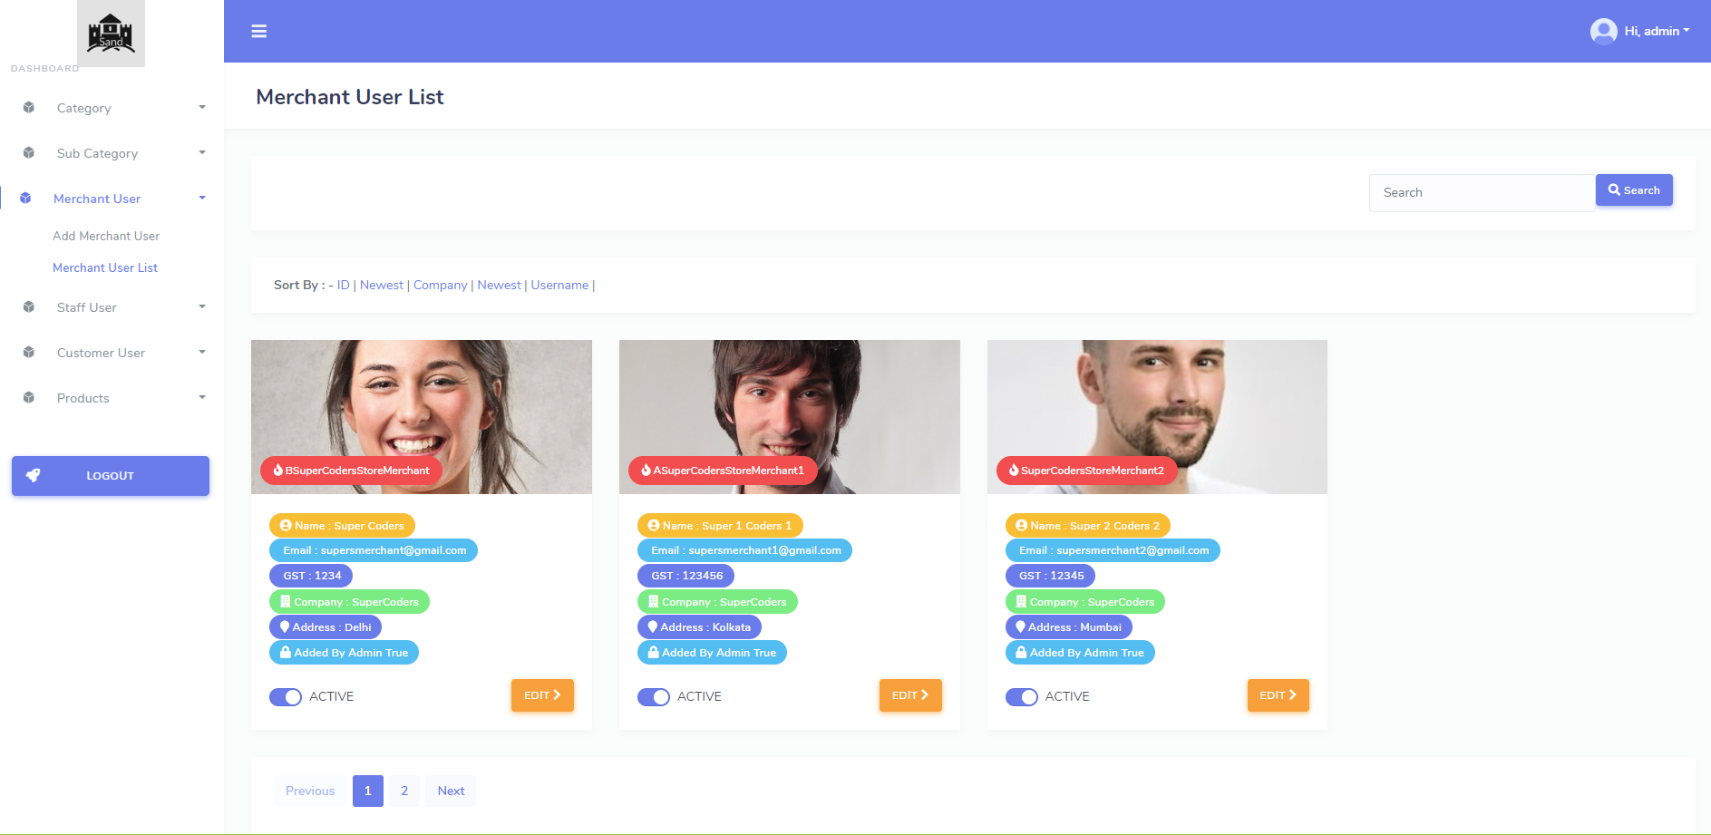
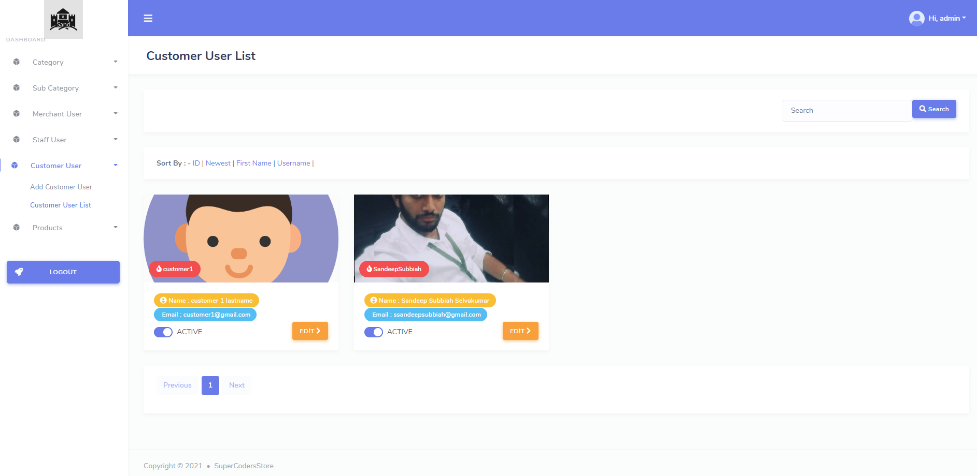
User Roles and Permissions

Slide 6

User Roles and Permissions

Slide 7
Category Management
Category Listing: The dashboard displays a list or table of existing categories, often with the ability to sort or filter them by various criteria such as name, date created, status, or other relevant attributes.
Add New Category: Administrators can add new categories by entering details such as category name, description, and any specific attributes related to the category. There might also be options to upload images or select a parent category for hierarchical structuring.
Edit Categories: Each category listed in the dashboard usually has an edit option. This allows administrators to modify category details, such as renaming the category or changing its attributes. Some systems allow bulk editing of categories for efficiency.
Delete Categories: Administrators can remove categories that are no longer needed. The dashboard might provide warnings or prompts if deleting a category could affect linked items or content.
Assigning Items to Categories: The dashboard typically allows for items (like products or articles) to be assigned to one or more categories, facilitating organization and retrieval. This could be done individually or in bulk through an upload process or selection tools.
Hierarchy Management: In more complex systems, categories can have subcategories, creating a hierarchy. The dashboard allows the management of these relationships, enabling administrators to structure the categories in a tree-like fashion.
Permissions and Access Control: Depending on the system, managing categories may involve setting permissions for who can create, edit, or delete categories. This is part of user role management within the dashboard.
Integration with Other Modules: Category management is often integrated with other dashboard modules, such as reporting, to filter data by category, or inventory management, to monitor stock levels by category.
Bulk Operations: For efficiency, dashboards often allow bulk operations on categories, such as importing/exporting category data, bulk editing, or updating category assignments for multiple items at once.
Search and Filter: Advanced dashboards provide a search and filter mechanism to quickly find categories or group them based on various parameters.

Slide 8

Category

Slide 9
Subcategory Management
Creating Subcategories:
Administrators can create subcategories within a main category to further refine classification. This is often done through a 'Create New' option where the admin selects the parent category from a dropdown menu or through a similar interface.
When creating a subcategory, details such as name, description, and any specific attributes or metadata can be added, similar to creating a main category.
Hierarchy Visualization:
The dashboard often provides a visual representation of the category hierarchy, such as a tree view, which shows the relationship between categories and subcategories.
This can help administrators understand the structure at a glance and manage it more effectively.
Editing Subcategories:
Admins can edit subcategories to change their name, associated attributes, and their position within the hierarchy (e.g., moving a subcategory to a different parent category).
Edits may also include changes to the access permissions for the subcategory if the system uses role-based access control.
Assigning Items to Subcategories:
Items or content can be assigned to specific subcategories either individually or in bulk.
Assignment can be part of the item creation process or done through an edit function for existing items.
Sorting and Ordering:
Dashboards may allow the reordering of subcategories for display purposes. For example, admins might order subcategories by popularity, alphabetically, or manually based on strategic importance.
Deletion and Merging:
When a subcategory is no longer needed, it can be deleted. The dashboard will typically provide prompts or warnings about the items that will be affected.
Subcategories can sometimes be merged, a feature that consolidates two or more subcategories into one, with items being re-categorized accordingly.
Integration with Search and Filtering:
The dashboard’s search and filter functions will generally include subcategories as parameters, making it easier to manage or find specific subsets of items or content.
Consistency Checks:
To prevent issues such as orphaned items (items that no longer have an associated category), the dashboard may include consistency checks or housekeeping functions that administrators can run when restructuring categories and subcategories.

Slide 10
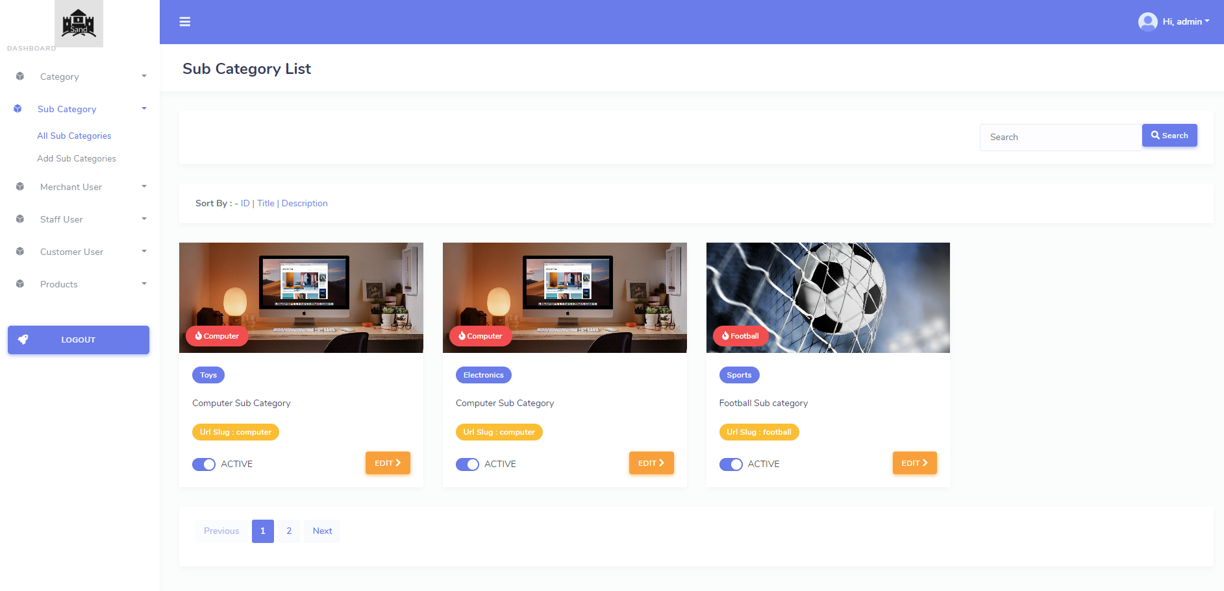
Subcategory

Slide 11
Merchant User Management
Account Creation and Setup:
Dashboards often allow administrators to create accounts for merchant users, entering information such as business name, contact details, and financial information.
Onboarding processes may include verification steps to confirm the legitimacy of the merchant, which can also be managed through the dashboard.
Role-Based Access Control (RBAC):
Administrators can assign roles to merchant users, defining what they can view and manipulate within the dashboard. This can include different levels of access, such as managing products, viewing sales reports, and handling customer service inquiries.
Profile Management:
Merchants can manage their own profiles through the dashboard, updating contact information, passwords, and payment details.
Administrators can also edit merchant profiles to assist with updates or corrections as needed.
Product Management:
Merchants usually have the ability to list, edit, and remove their products or services. This includes setting prices, uploading product images, and defining categories.
The dashboard may include bulk upload features for merchants with large inventories.
Order and Sales Tracking:
Dashboards provide functionality for merchants to view and manage customer orders. This can include processing refunds, handling returns, and updating order statuses.
Real-time sales data and history can be viewed, which is essential for merchants to track their performance.
Financial Management:
Payment processing features allow merchants to manage how they receive payments and view transaction histories.
The dashboard can also include functions for handling invoices, taxes, and other financial aspects of the merchant's business.
Performance Analytics and Reporting:
Merchants can access analytics on sales, customer visits, conversion rates, and other performance metrics.
Custom reports can be generated to help merchants understand their business trends and identify areas for improvement.

Slide 12
Staff User Management
User Account Creation:
Admins can create individual accounts for each staff member, often including their name, contact information, and department.
Unique login credentials are provided to maintain security and accountability.
Role Assignment:
Staff members are assigned roles based on their job functions. Each role comes with specific permissions that determine what the user can see and do within the dashboard.
Roles can range from view-only access for some staff to full administrative rights for others.
Access Levels and Permissions:
The dashboard implements Role-Based Access Control (RBAC) to define different levels of access. For instance, finance staff may have access to billing and invoicing features, while marketing staff may have access to promotional tools.
Permissions are granular, allowing for precise control over which features users can access and what actions they can perform.
Activity Monitoring and Auditing:
The dashboard often includes audit logs or activity tracking features, which record the actions taken by each staff user. This helps in ensuring accountability and tracing any changes made within the system.
Admins can review logs to monitor productivity, investigate incidents, or understand user behavior.
Training and Onboarding:
New staff members can be guided through training modules within the dashboard to familiarize them with the functionalities they'll be using.
Help resources, tutorials, or knowledge bases can be integrated into the dashboard for ongoing support.
Dashboard Customization:
The dashboard may be customizable to some extent, allowing staff to set up their workspace with widgets or shortcuts to frequently used functions or data.
Personalization can help staff work more efficiently and focus on their specific tasks.
Task Assignment and Management:
Admins can assign tasks to staff within the dashboard. Task management features enable tracking of progress and deadlines.
Notifications and reminders can be set up to alert staff of pending or completed tasks.

Slide 13
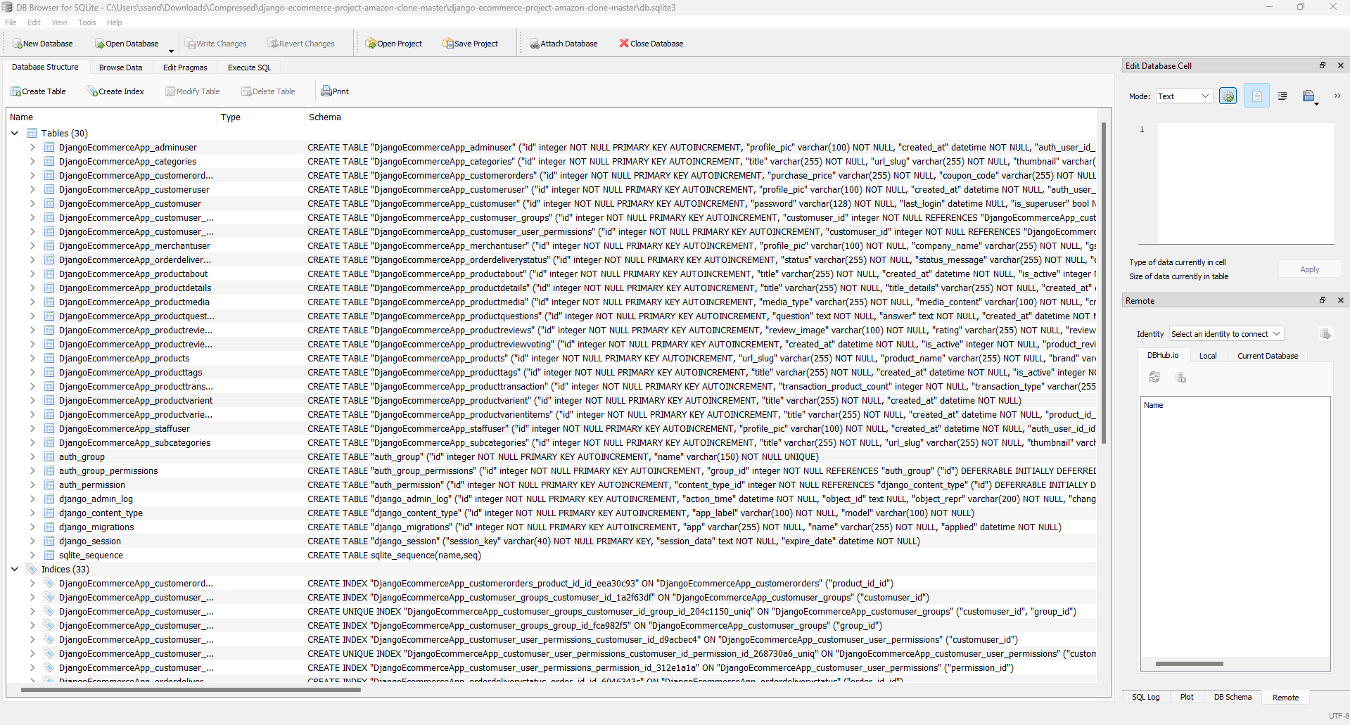
Database Overview

Slide 14
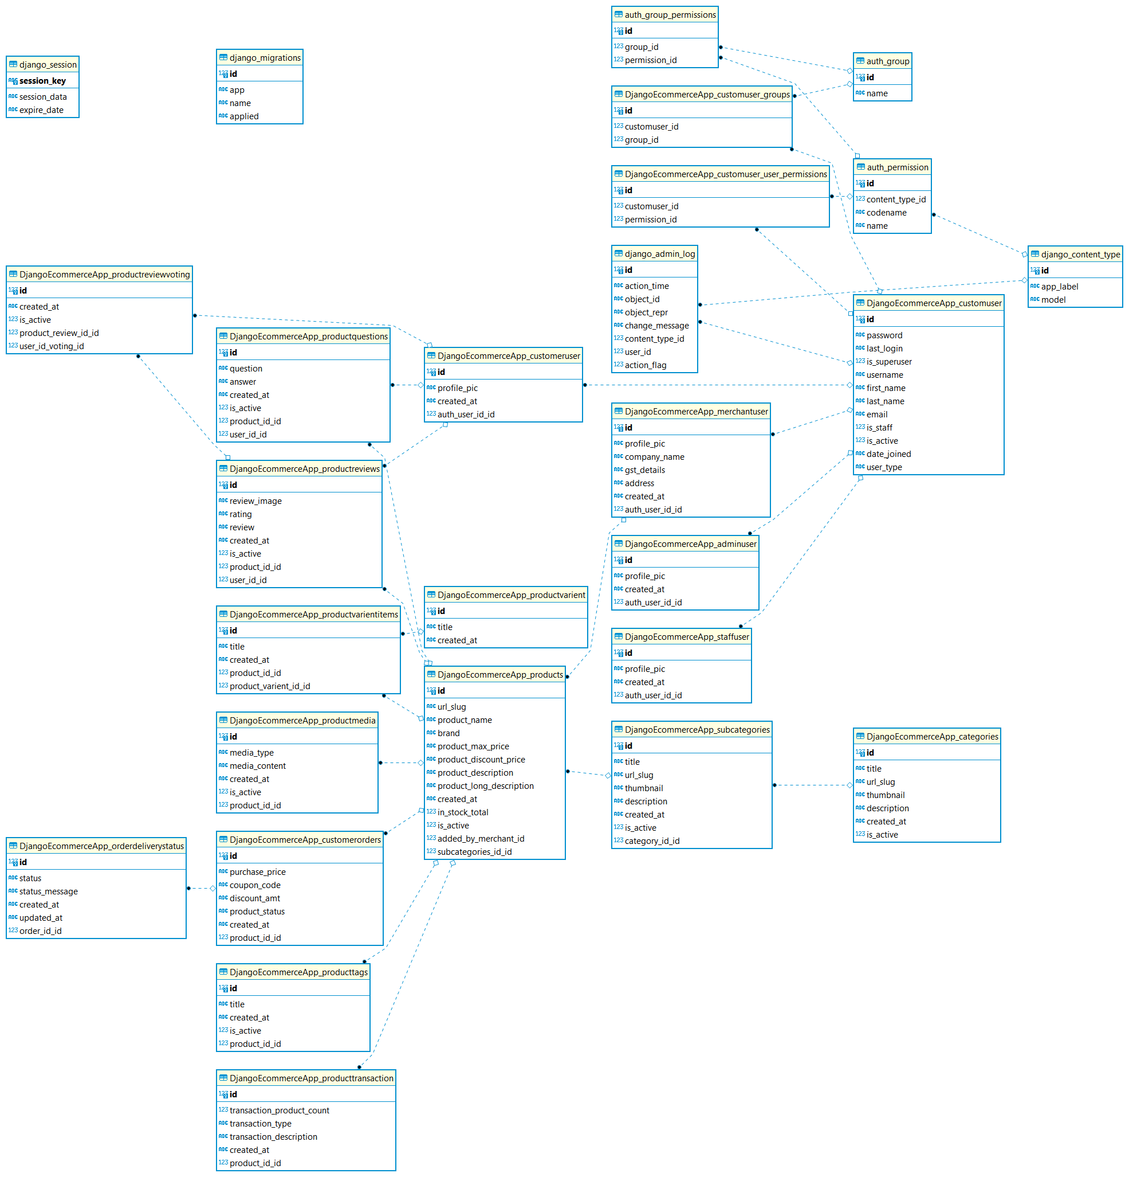
UML Diagram

Slide 15
Thank you.

